Slide 1

HOGWARTS PYTHON
Beginner Wizard Class

Slide 2
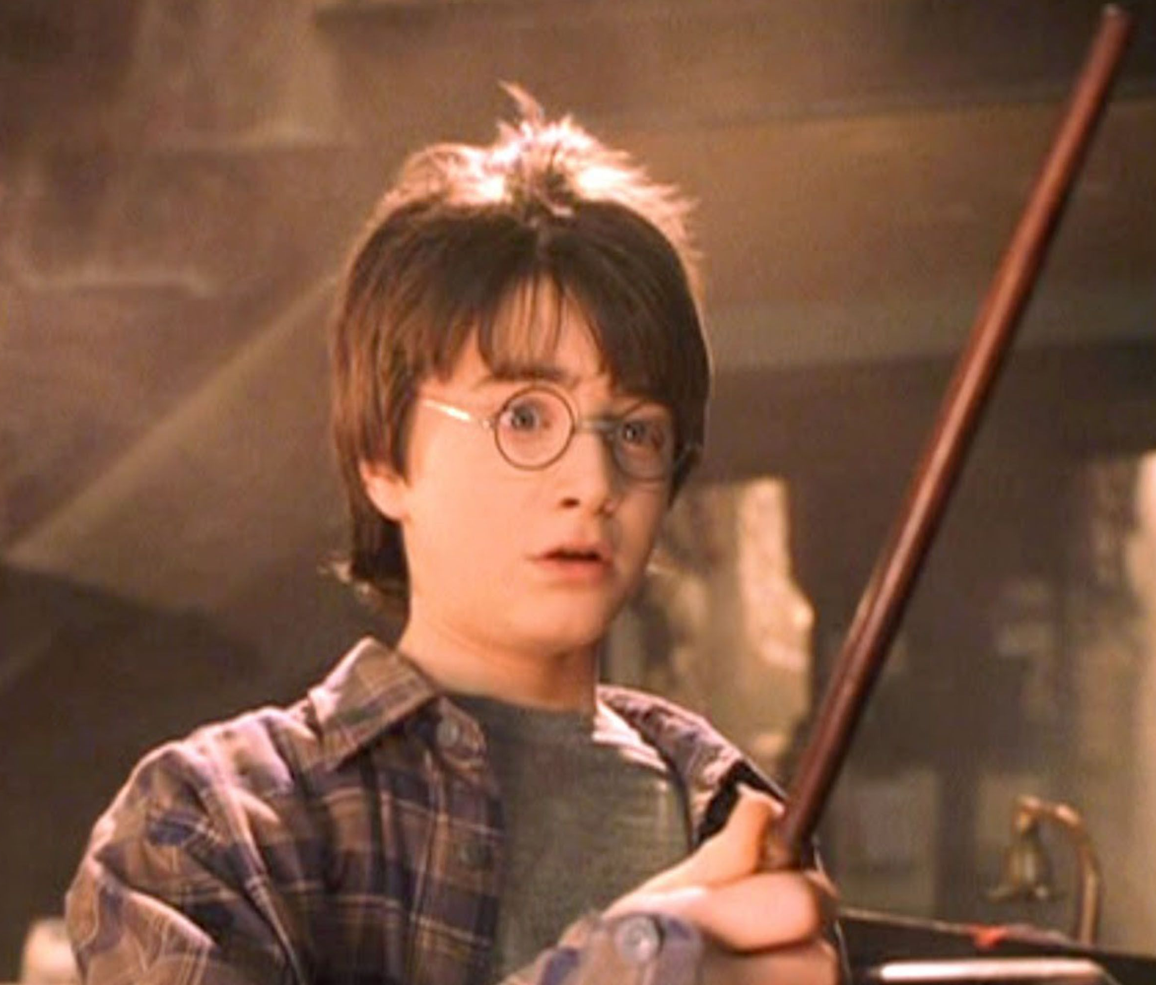
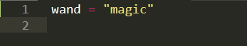
Variables are containers that have names and hold variables

Slide 3
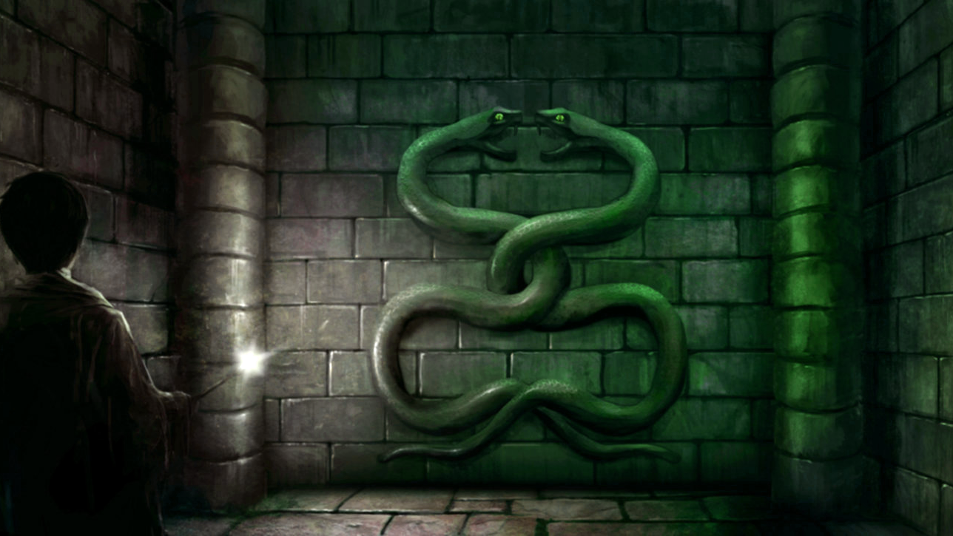
What is Python
Python is an interpreted, interactive, object-oriented programming language.
It incorporates modules, exceptions, dynamic typing, very high level dynamic data types, and classes.
Python combines remarkable power with very clear syntax. It has interfaces to many system calls and libraries, as well as to various window systems, and is extensible in C or C++.
It is also usable as an extension language for applications that need a programmable interface.
Finally, Python is portable: it runs on many Unix variants, on the Mac, and on Windows 2000 and later.

Slide 4
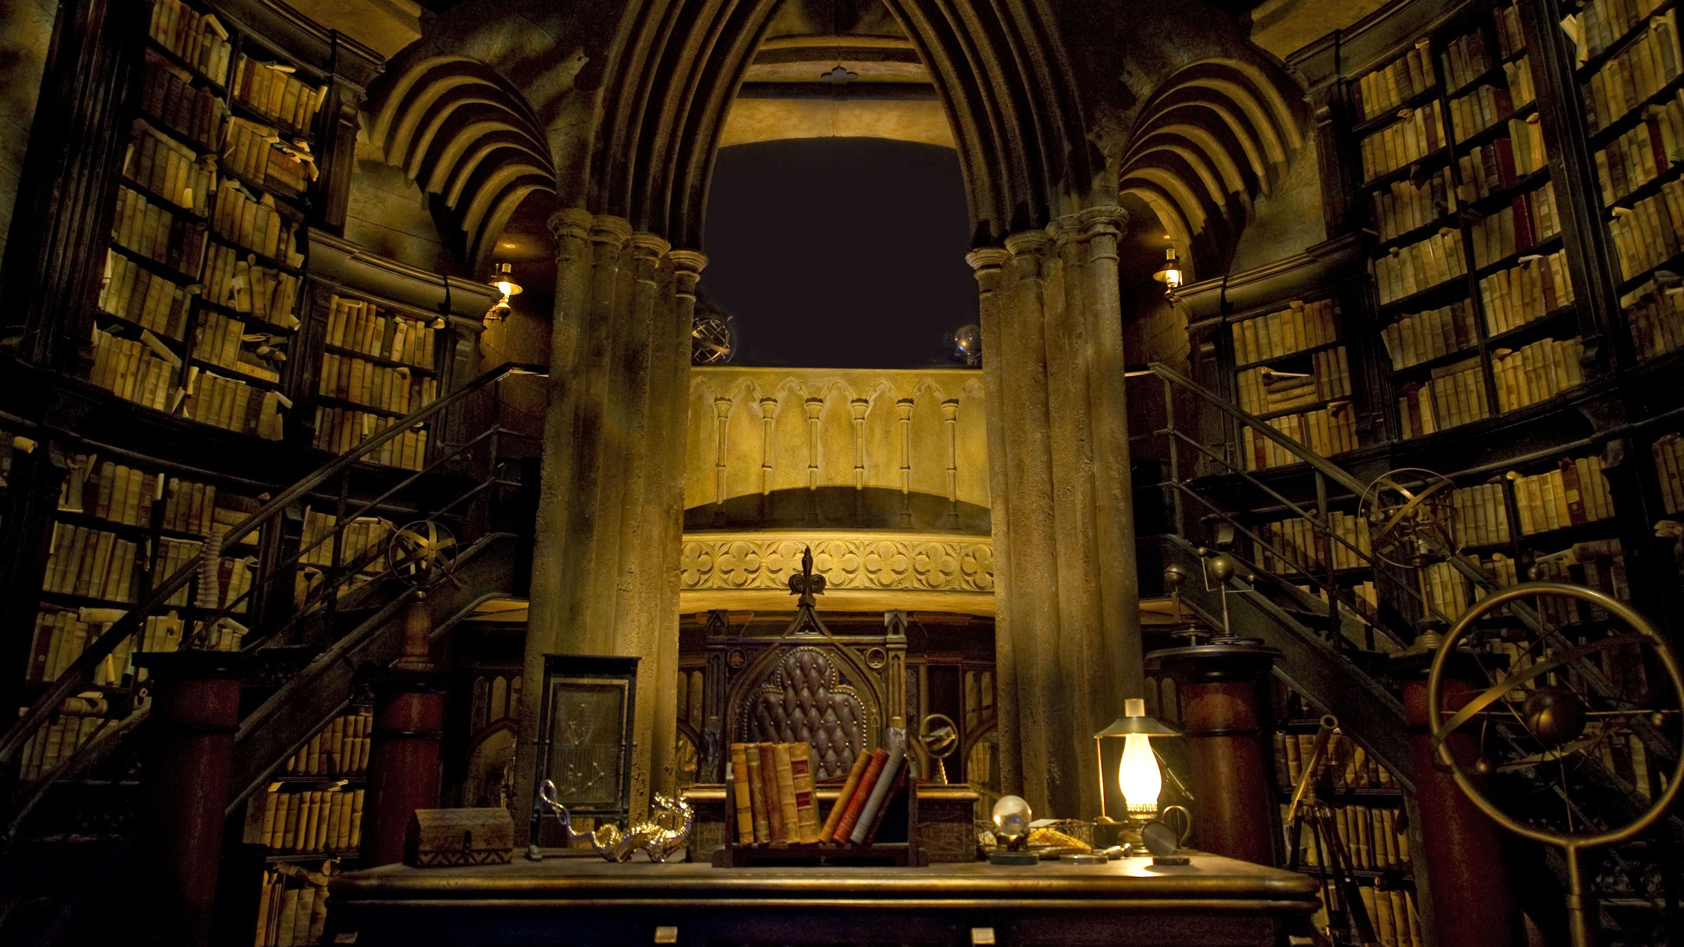
Variables
Variables can’t start with a number
Variables can’t have spaces
Variable names can’t be reserved Python commands

Slide 5
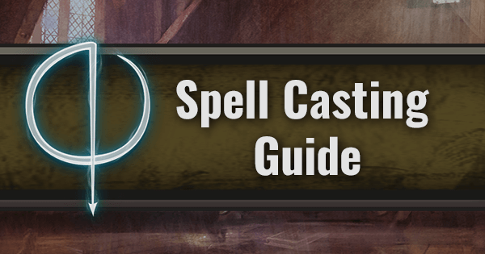
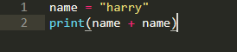
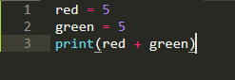
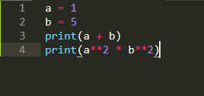
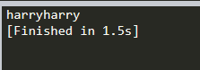
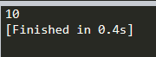
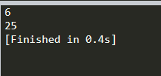
Variables can be used in different ways

Slide 6
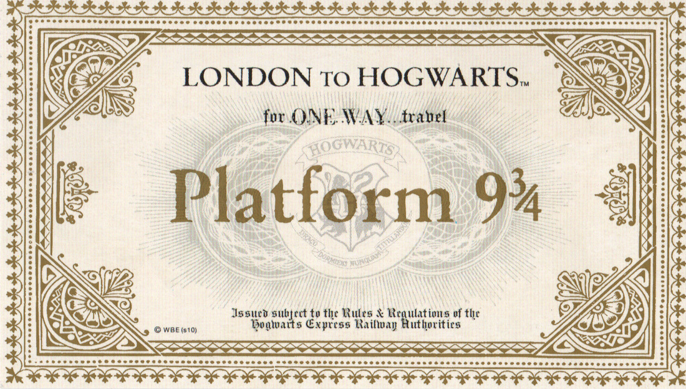
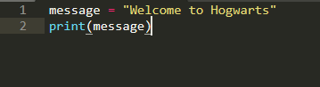
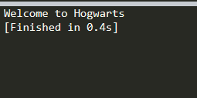
Variables
Variables are containers that hold information

Slide 7
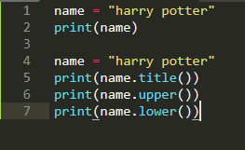
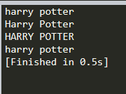
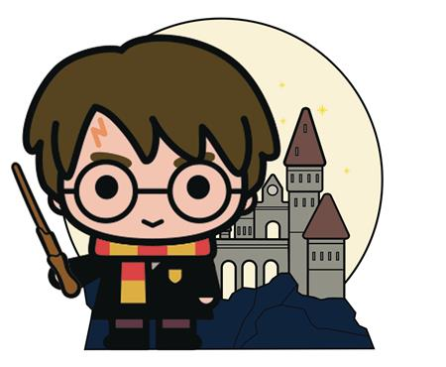
Strings and Formatting
Strings are basically text (unlike numbers, code, etc.)
Strings can have a single ‘’ or double “” quote
Strings can be formatted and combined

Slide 8

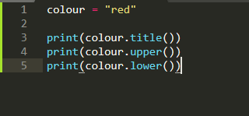
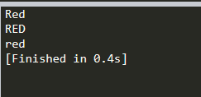

Slide 9
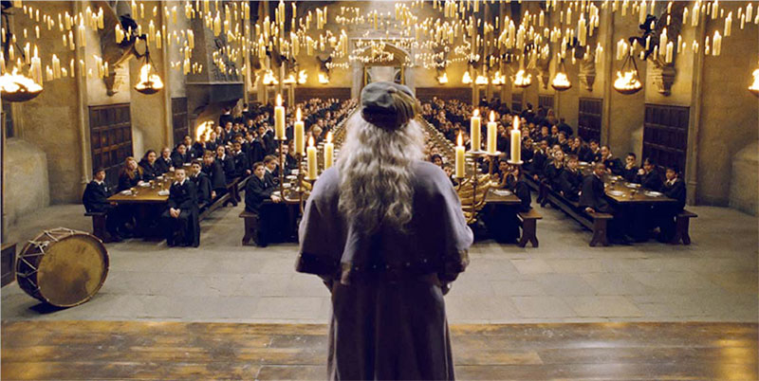
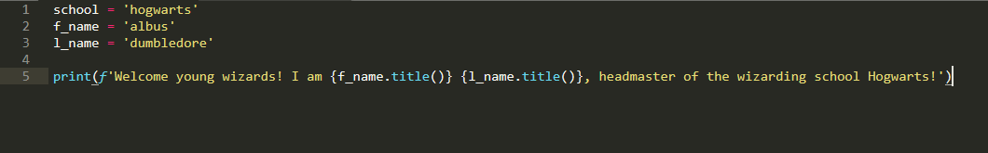
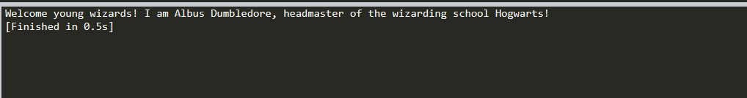
Using f-strings (formatted strings)

Slide 10
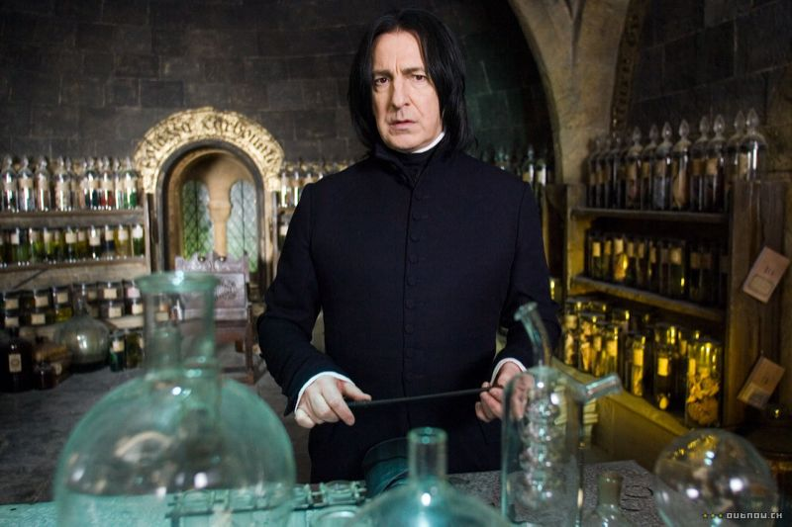
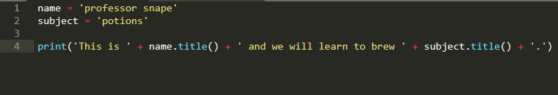
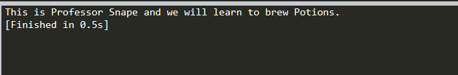
Using a join instead of an f-string

Slide 11
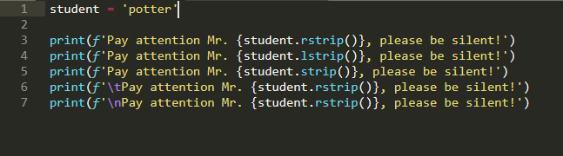
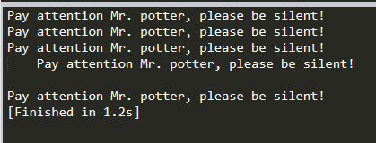
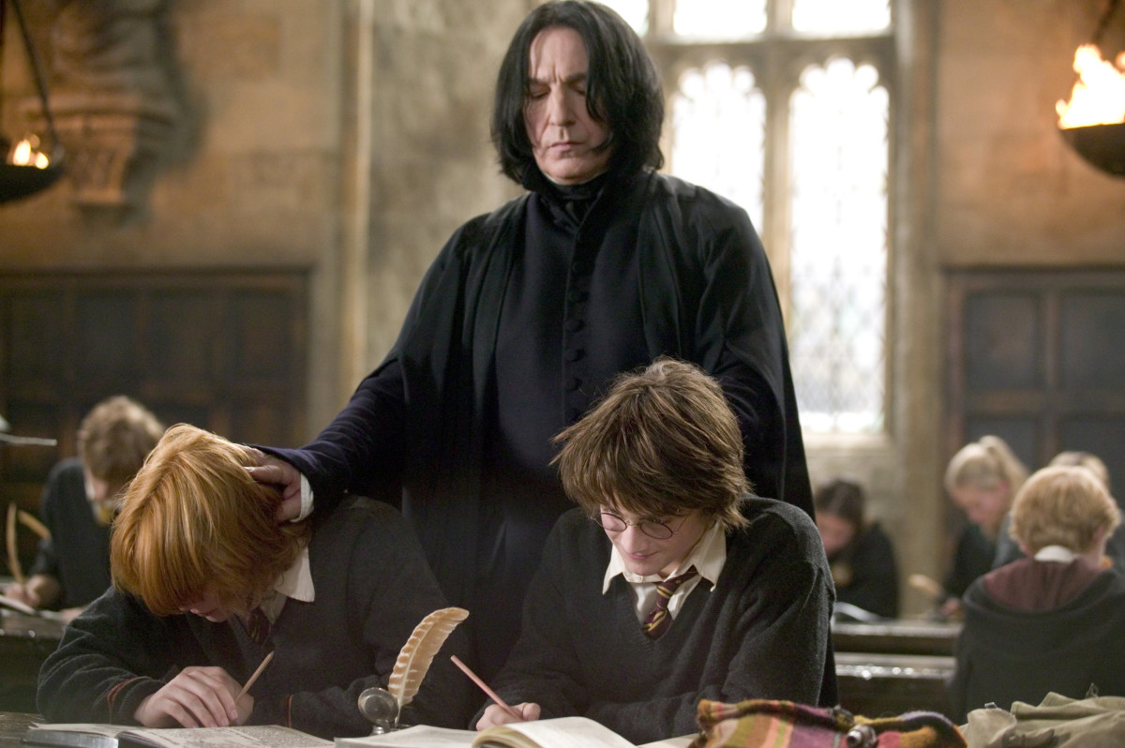
Whitespace and strip
.rstrip()
.lstrip()
.strip()
\n
\t

Slide 12
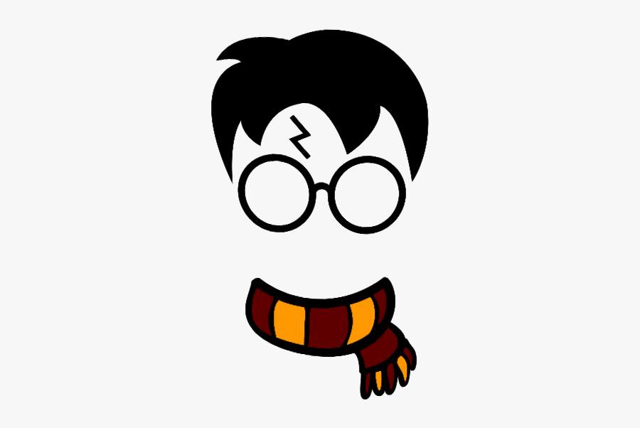
Integers and floats
Integers are whole numbers
Floats are fractions (numbers with a decimal)
Addition +
Subtraction –
Multiplication *
Division /
Exponents **
Order of operation

Slide 13

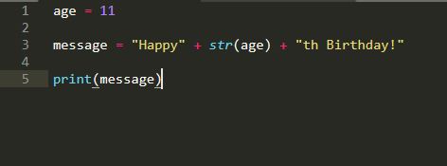
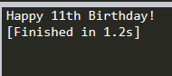
Integers and floats
These can be confused with strings, hence the (str) function
This is not needed when using a f-string

Slide 14

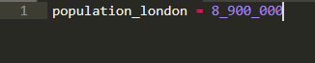
Underscore in Numbers
Make large numbers easier to read

Slide 15
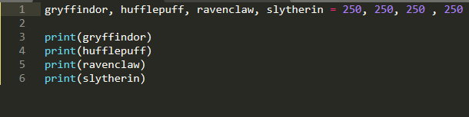
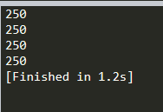

Multiple Assignment

Slide 16
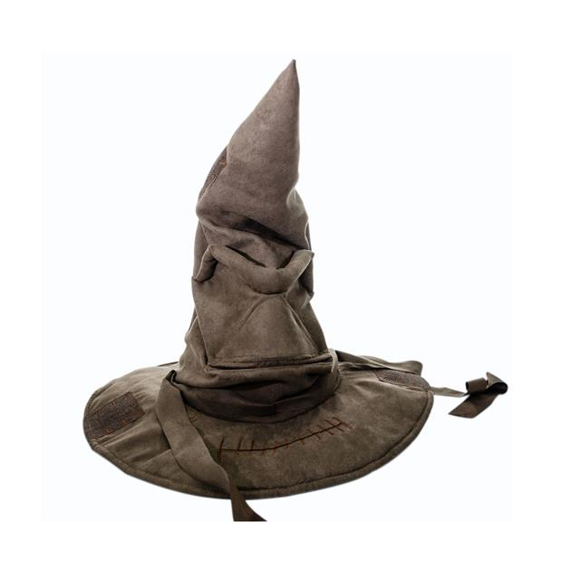
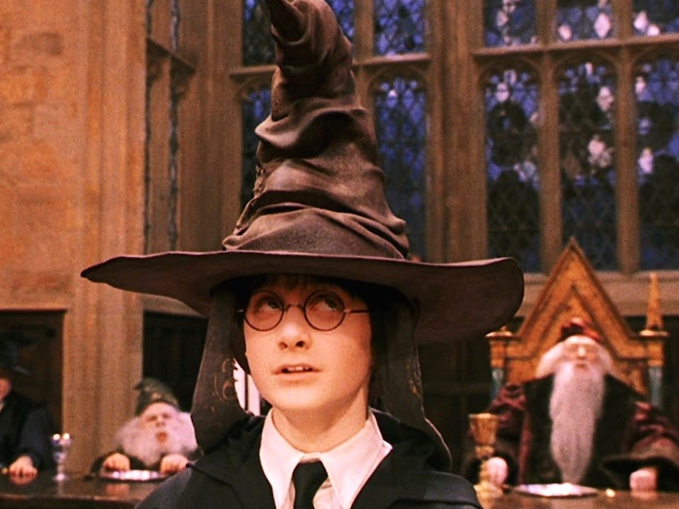
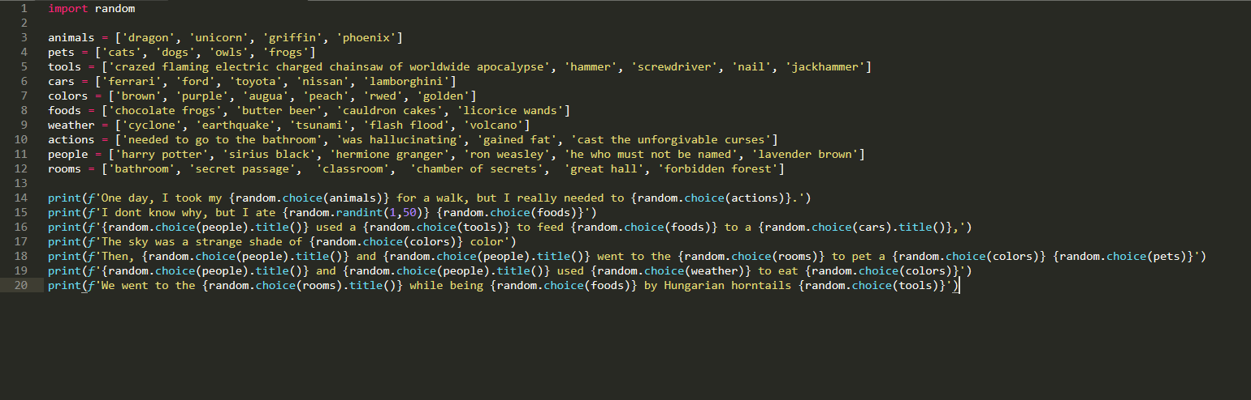
Game

Slide 17
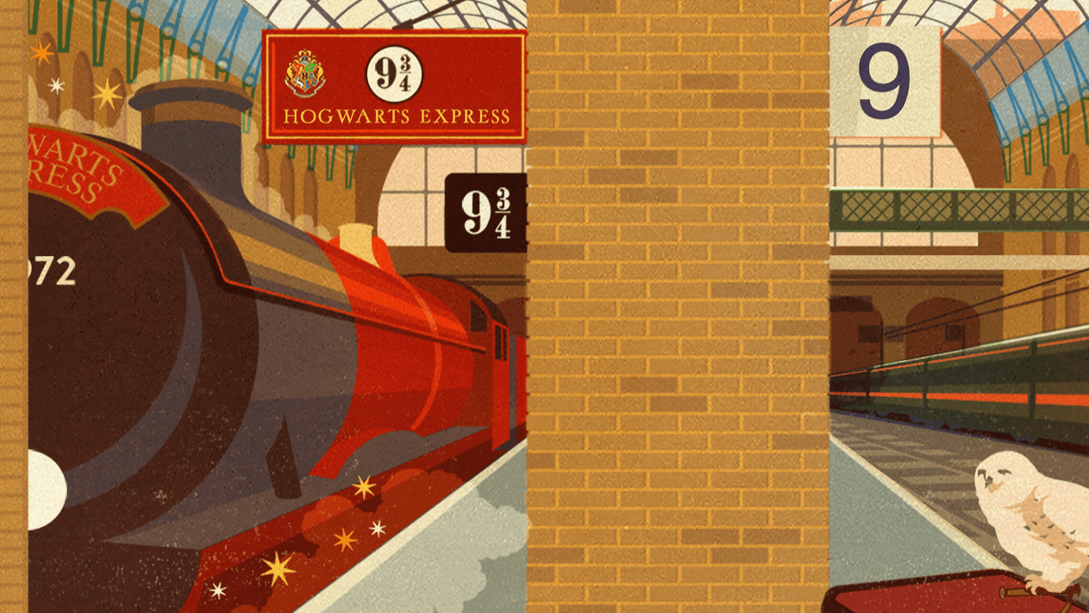
Thank you for participating!
I hope you had fun and learned a lot of neat things about Python!

